Slide 1
Circulatory & Cardiovascular Problems www.heart.org

Slide 2
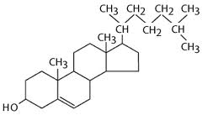
High Cholesterol
Cholesterol is a soft, fat-like substance in your blood and cells.
There are 2 kinds of cholesterol:
LDL (Low-Density Lipoprotein) → ☹
HDL (High-Density Lipoprotein)→☺
LDL cholesterol can build up in your blood stream and make it hard for blood to pass through.

Slide 3
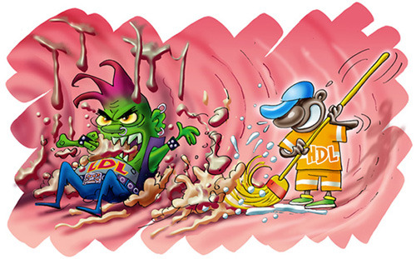
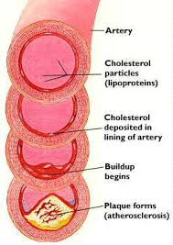
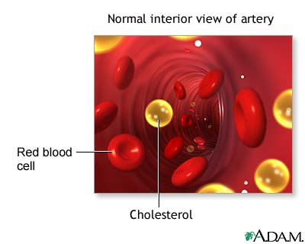
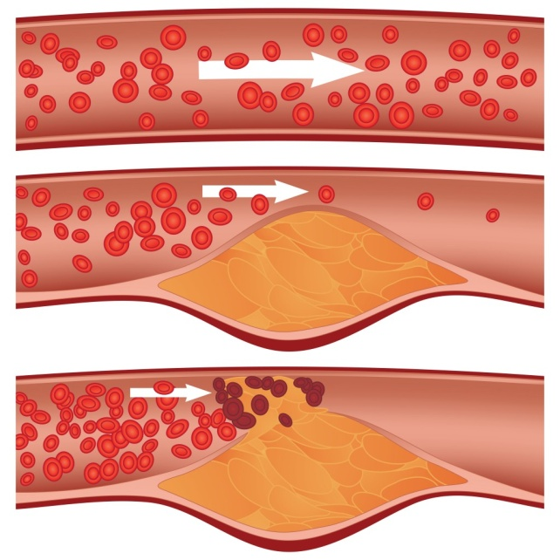
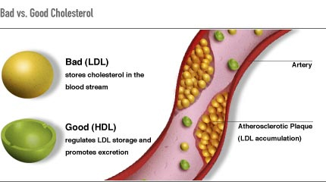

Slide 4
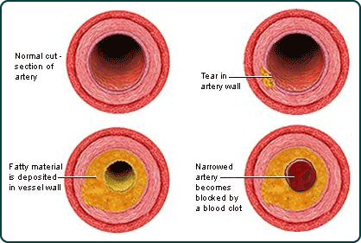
http://www.cdc.gov/cholesterol/faqs.htm

Slide 5
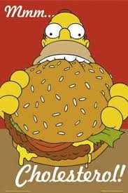
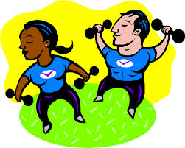
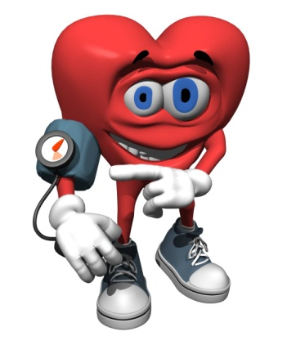
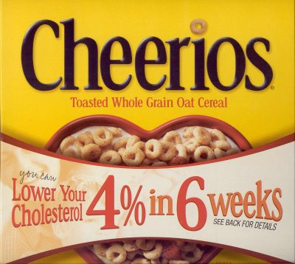
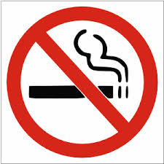
High Cholesterol
How can we prevent high cholesterol?!
Eat a healthy diet.
Cholesterol is found in animal products
Dairy products, baked goods, and fast food have a lot of cholesterol
Maintain a healthy weight.
Exercise regularly.
Don’t smoke!
www.cdc.gov

Slide 6
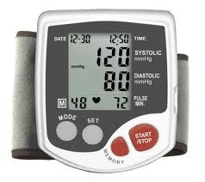
High Blood Pressure
What is blood pressure?
It measures how forcefully the blood is coming through your arteries.
Think about faucets at your house– if they are all turned on, what is the water pressure like? What about if one is off?
What is normal blood pressure?
<<less than 120/less than 80
What is considered high?
More than 140/more than 90

Slide 7
High or Low?
1. 120/80
2. 110/70
3. 140/90
The top number is “systolic”: pressure in the arteries when the heart beats (muscle is contracting)…
The bottom number is “diastolic”: the pressure in the arteries between beats (the muscle is relaxing between beats and refilling with blood)…

Slide 8
High blood pressure
Ways to prevent high blood pressure are similar to high cholesterol.
If your blood pressure is too high, it stretches out the arteries and can cause issues like:
Weak blood vessels
Scarred blood vessels (because they’re too stretched)
Blood clots
Blood clots can lead to stroke or heart attack ☹

Slide 9
Heart attack
Happens when blood flow to the heart is severely reduced or cut off completely due to a blood clot.
This can happen because of fat, plaque, and cholesterol deposits… they block the blood flow. When a piece breaks off, a clot can form around it and block the arteries, as well.

Slide 10
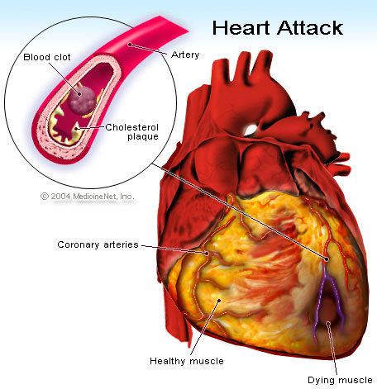

Slide 11
Heart attack
If it is blocked for too long, part of the heart can die (it is a muscle– that’s what happens when muscles don’t get enough oxygen and nutrients).
Usually the heart can keep functioning after a heart attack, sometimes it can’t.
Ways to prevent heart attacks are the same as high cholesterol.

Slide 12
Stroke
Happens when one of the blood vessels in the brain are blocked by a clot or burst.
This, like a heart attack does to the heart, causes a lack of oxygen to the brain.
Can be minor or major…
Major strokes can cause paralysis/death…

Slide 13
Stroke – Quick Test!
Act F.A.S.T!
Every 40 seconds someone in the US suffers a stroke!
F – Face
Ask the person to smile. Does one side droop?
A – Arms
Ask the person to raise both arms. Does one drift downward or is the person unable to move it at all?
S – Speech
Ask the person to repeat a simple sentence. Does the speech sound slurred or strange?
T – Time
CALL 911 IMMEDIATELY!! The longer the time period before the person receives treatment the more damage to the brain.

Slide 14
Resources
http://www.wikihow.com/Know-if-You-Are-Having-a-Stroke
http://www.examiner.com/article/act-f-a-s-t-stroke-quick-test
http://www.nlm.nih.gov/medlineplus/magazine/issues/winter10/articles/winter10pg10a.html

