Slide 1
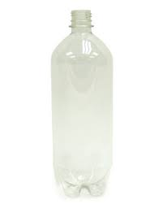
Earn Tickets!
1 2L bottle: 1 Ticket
1 pack of 4x6in. index cards: 2 Tickets

Slide 2
Ecosystems Glossary

Slide 3
Homework Tonight:
Make flashcards for words 1-10.
Keep these in your plastic bag. You may keep these in your desk OR your locker space/cubby. You DO NOT need to bring them to Science everyday.

Slide 4
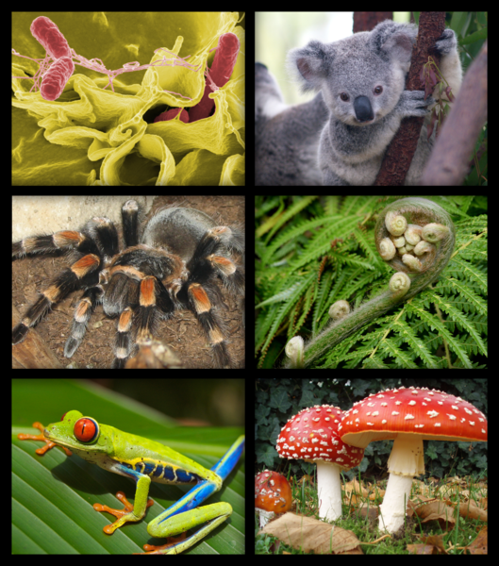
ORGANISM
Any living thing that carries out its life on its own.

Slide 5
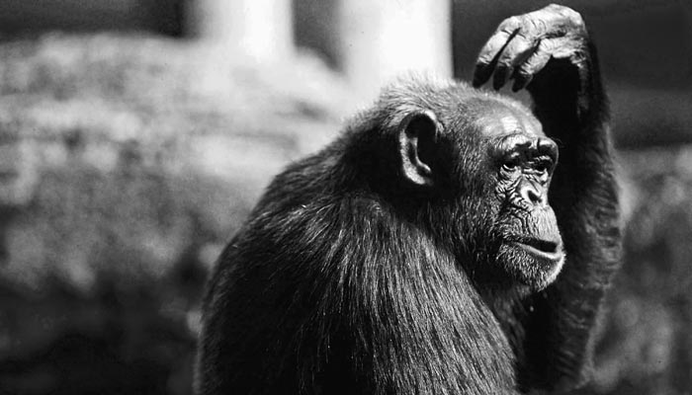
BUT…
What makes a living
thing a living thing?!

Slide 6
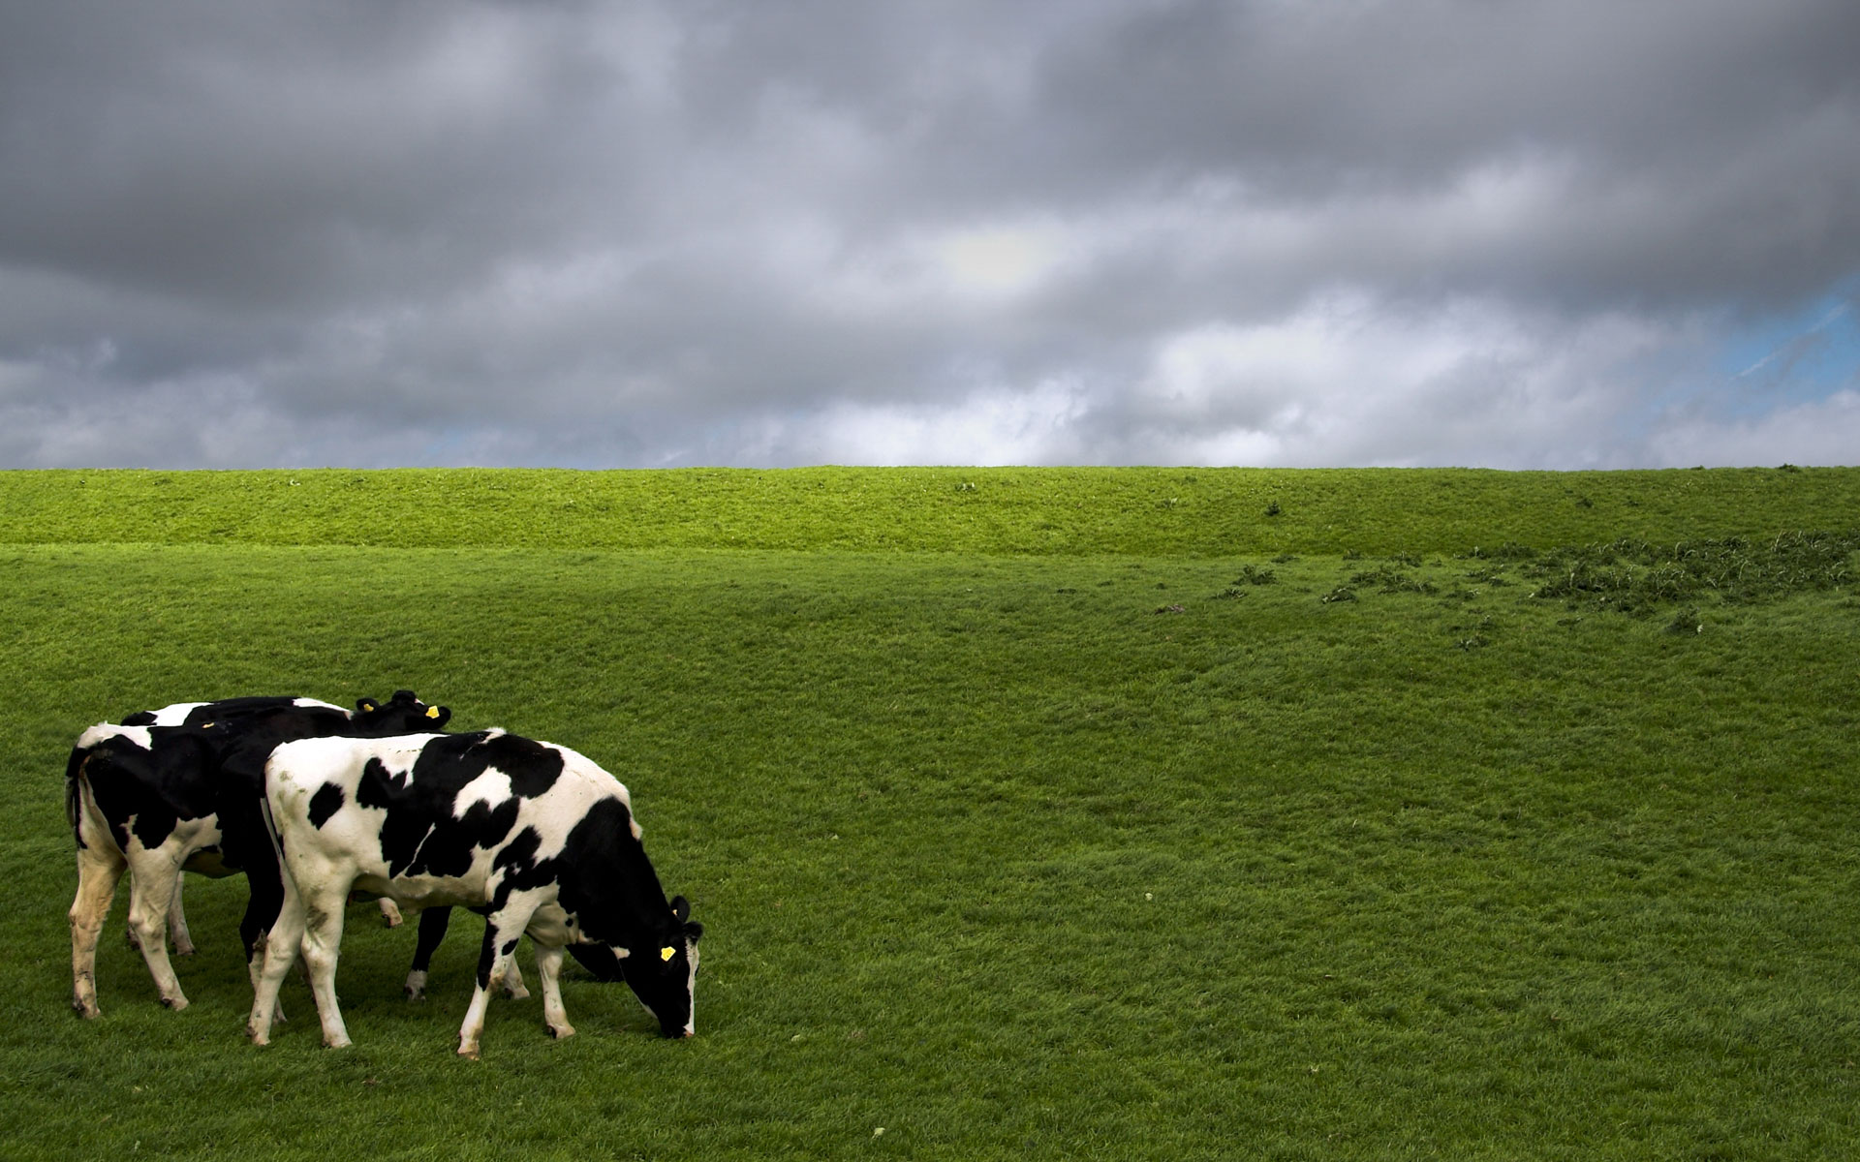
An organism…
GROWS and develops.
Uses ENERGY…
Makes food (photosynthesis), OR
Consumes food
Can REPRODUCE.
RESPONDS to its environment.
Gets rid of WASTE.

Slide 7
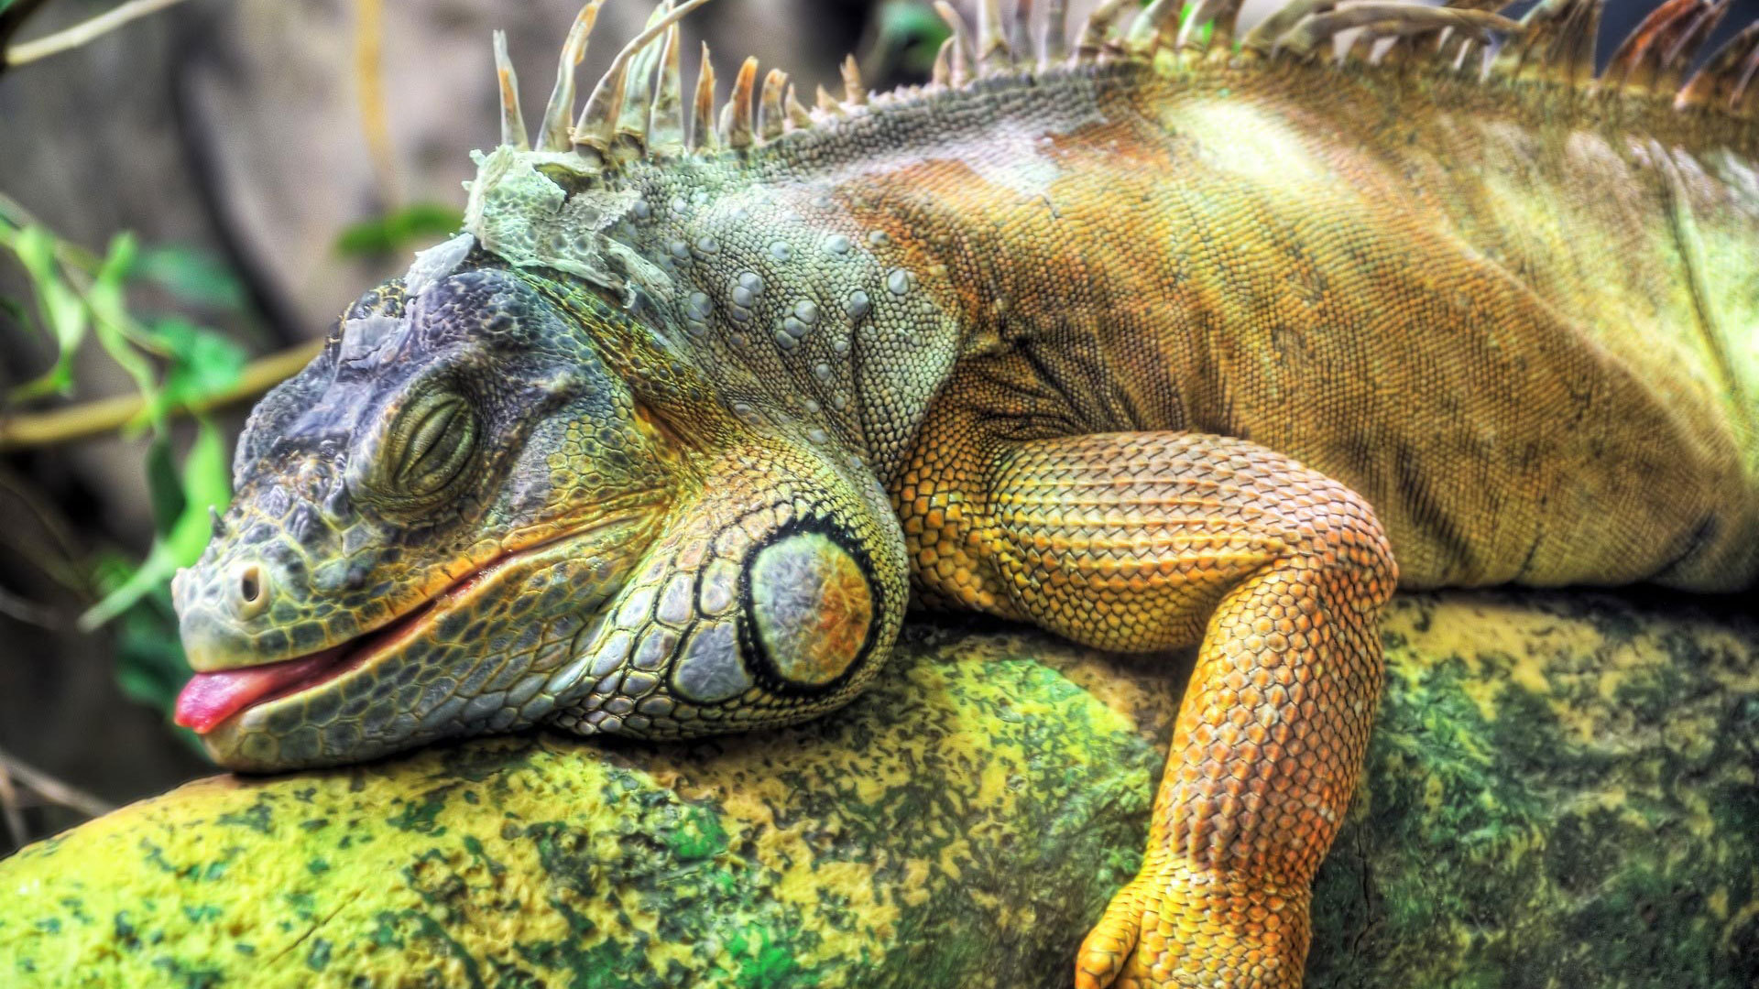
Grow?
Use energy?
Reproduce?
Respond?
Waste?

Slide 8
Grow?
Use energy?
Reproduce?
Respond?
Waste?

Slide 9
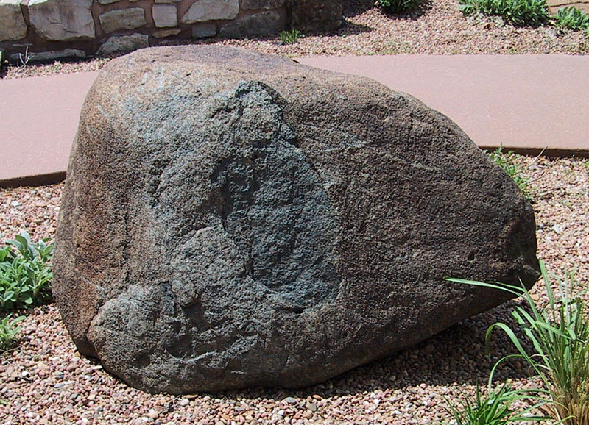
Grow?
Use energy?
Reproduce?
Respond?
Waste?

Slide 10
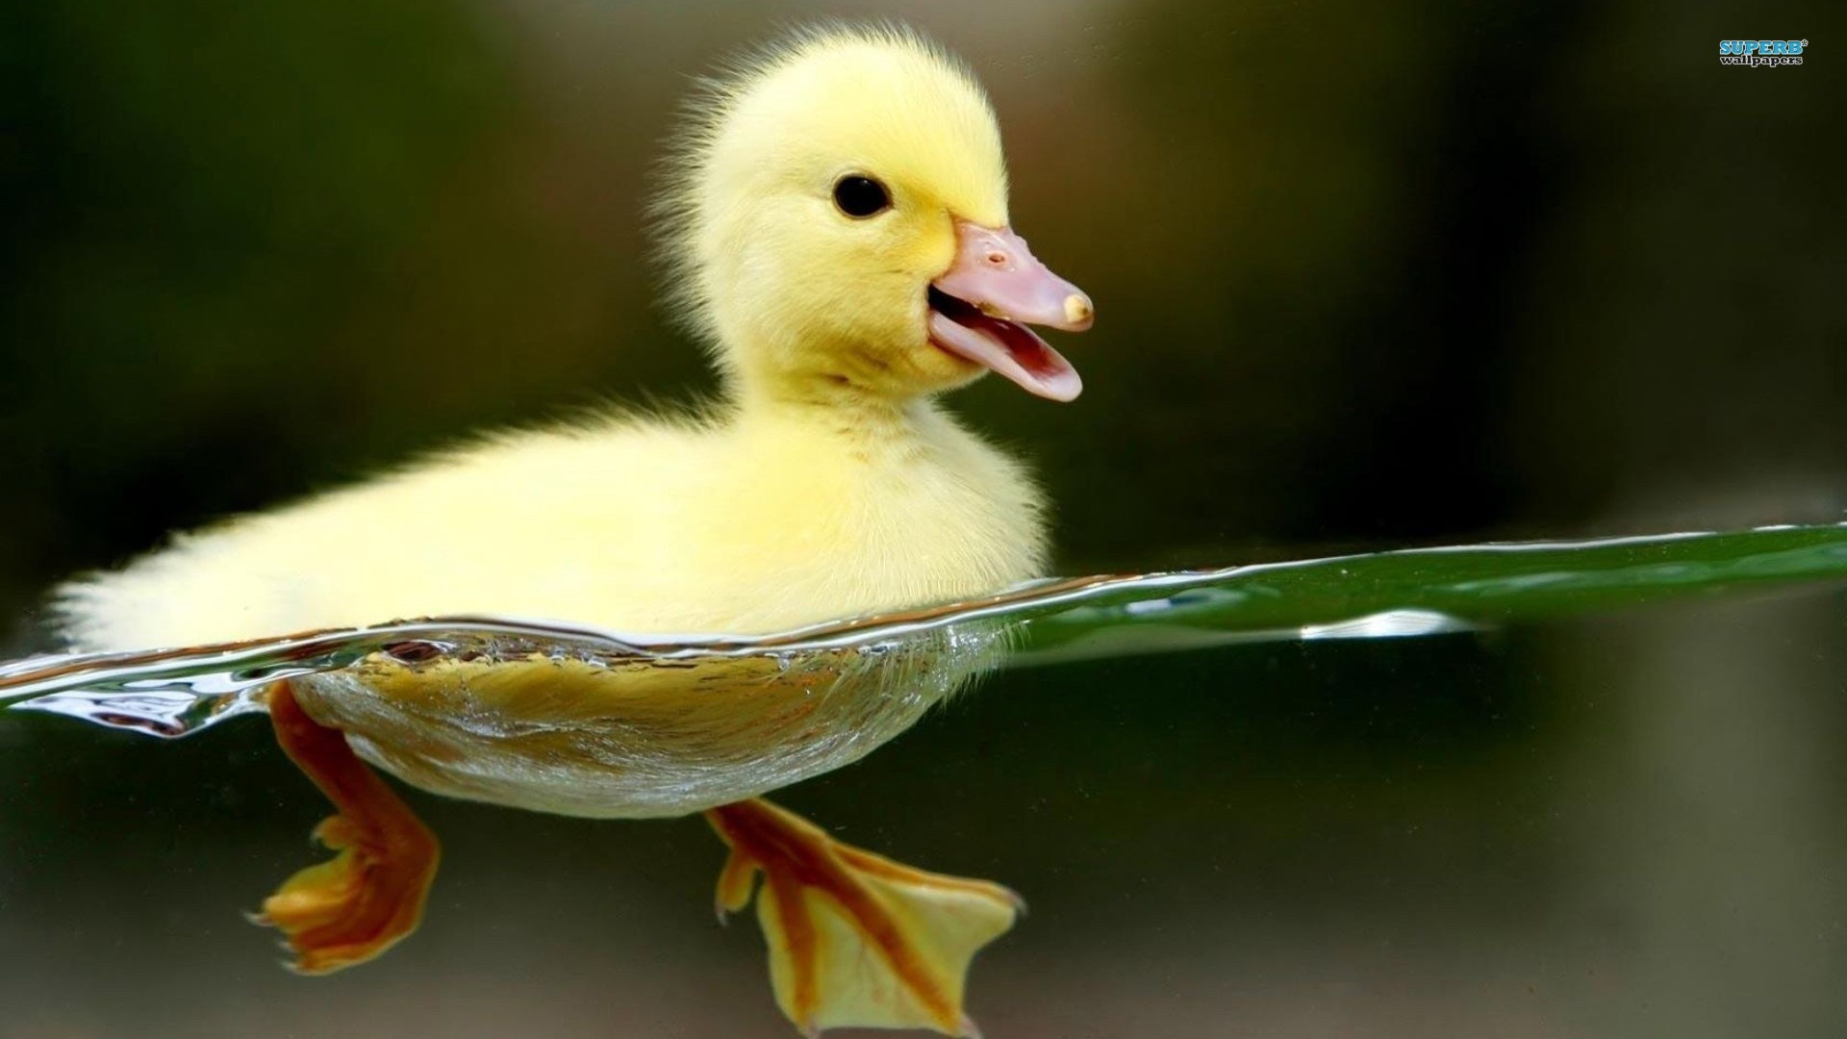
Grow?
Use energy?
Reproduce?
Respond?
Waste?

Slide 11
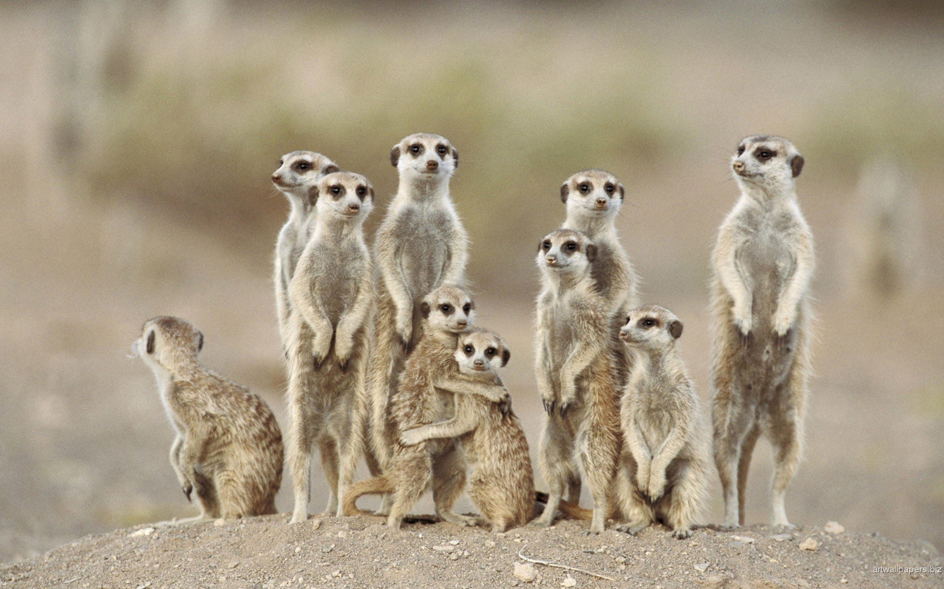
Grow?
Use energy?
Reproduce?
Respond?
Waste?

Slide 12
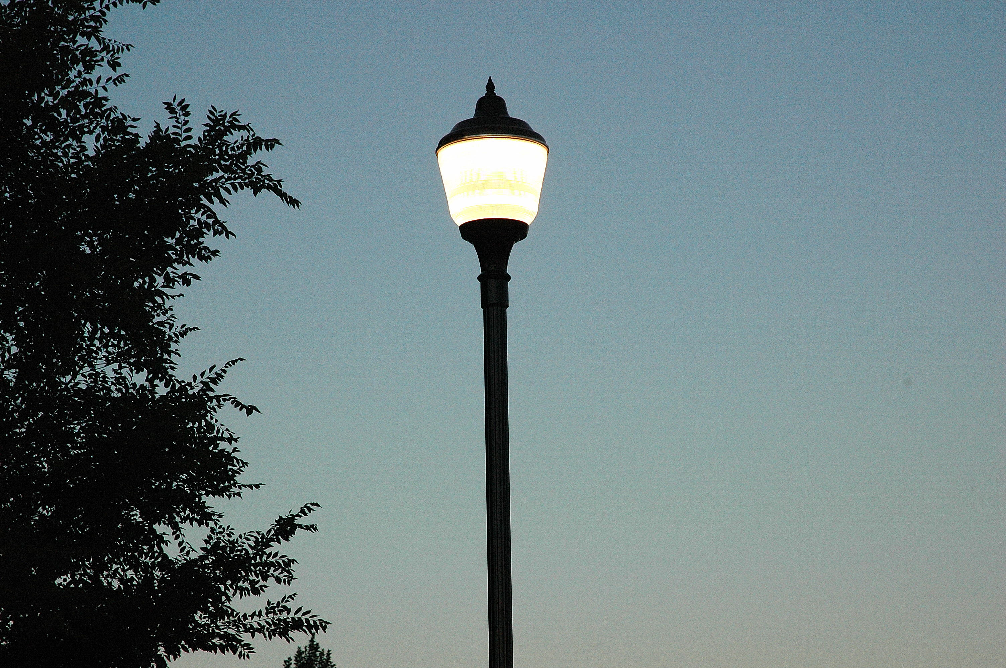
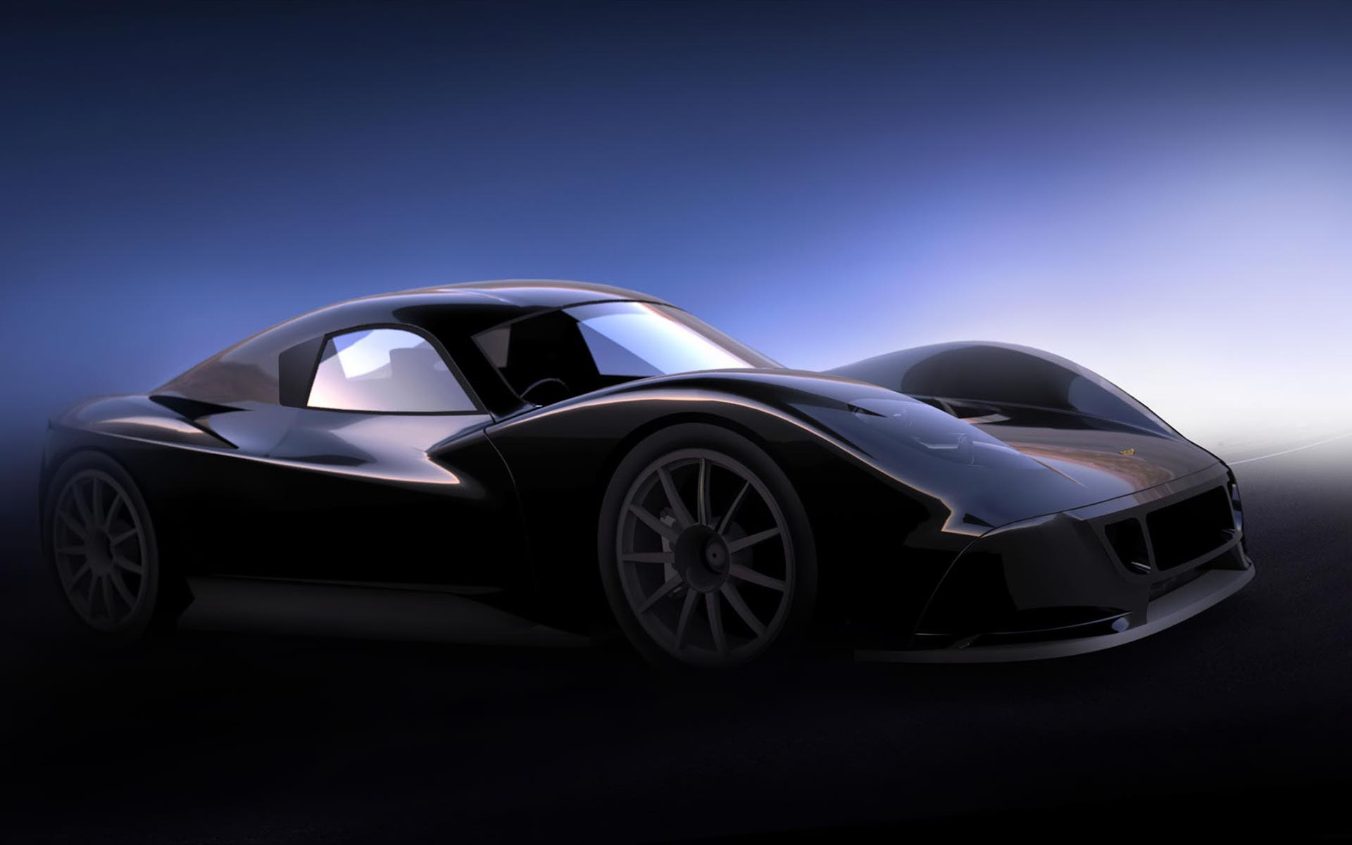
Grow?
Use energy?
Reproduce?
Respond?
Waste?

Slide 13
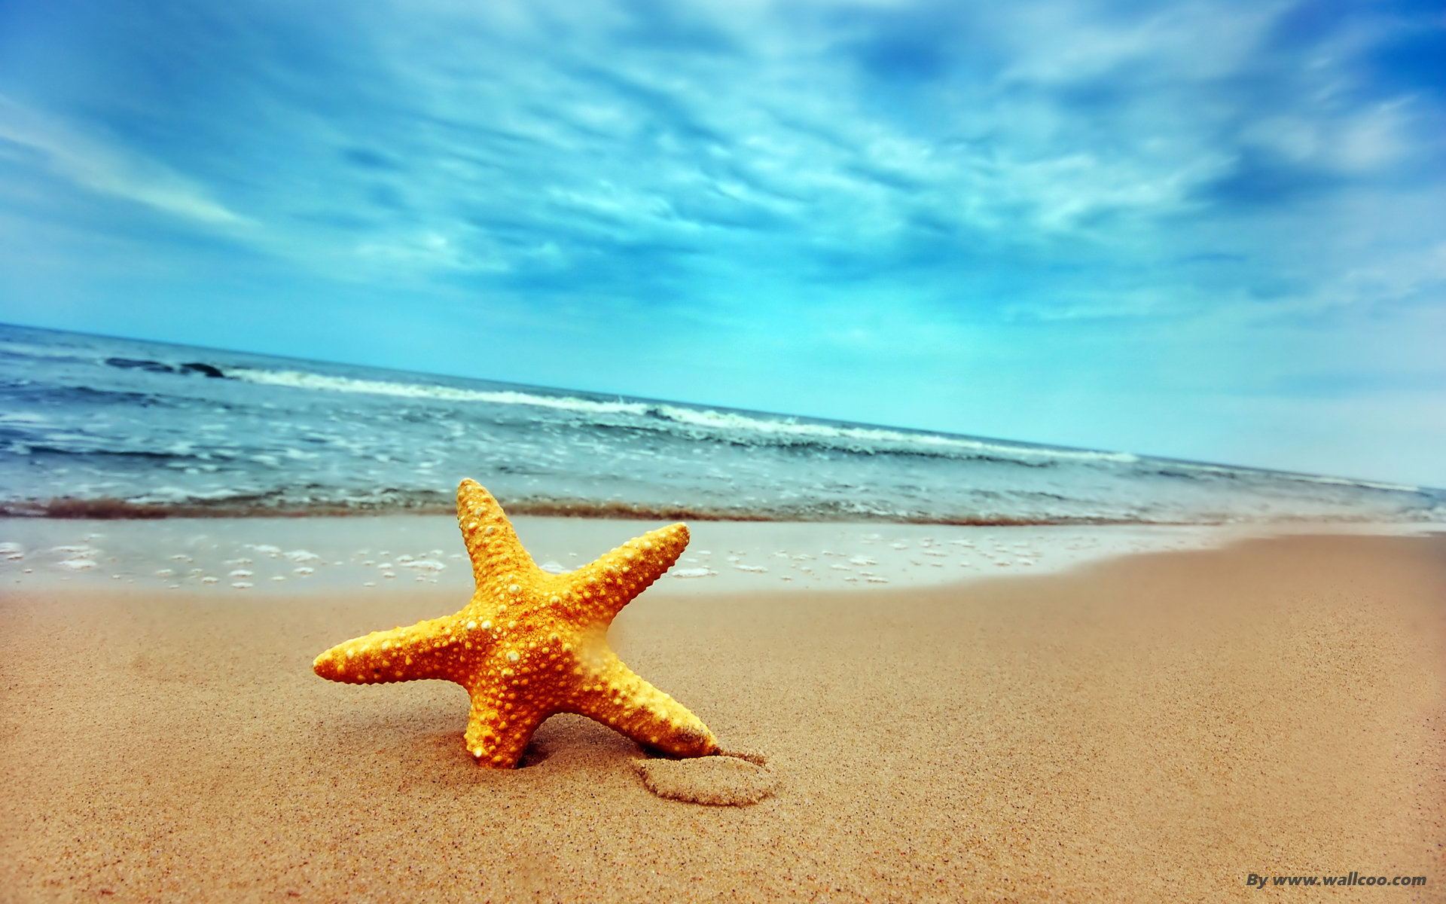
Grow?
Use energy?
Reproduce?
Respond?
Waste?

Slide 14
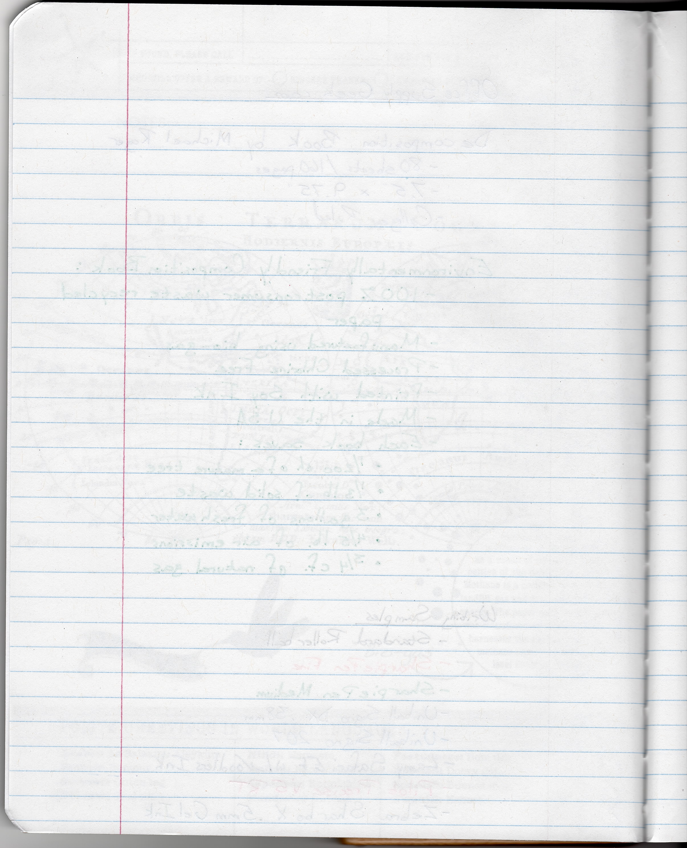
In Your Science Notebooks…
1. An organism is…
2. AN ORGANISM:
___________
___________
___________
___________
___________

