Slide 1
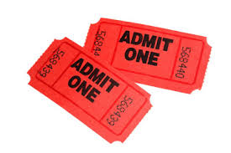
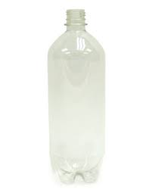
Earn Tickets!
1 2L bottle: 1 Ticket
1 pack of 4x6in. index cards: 2 Tickets

Slide 2
Homework Tonight:
Make flashcards for words 11-20.
Keep these in your plastic bag. You may keep these in your desk OR your locker space/cubby. You DO NOT need to bring them to Science everyday.

Slide 3
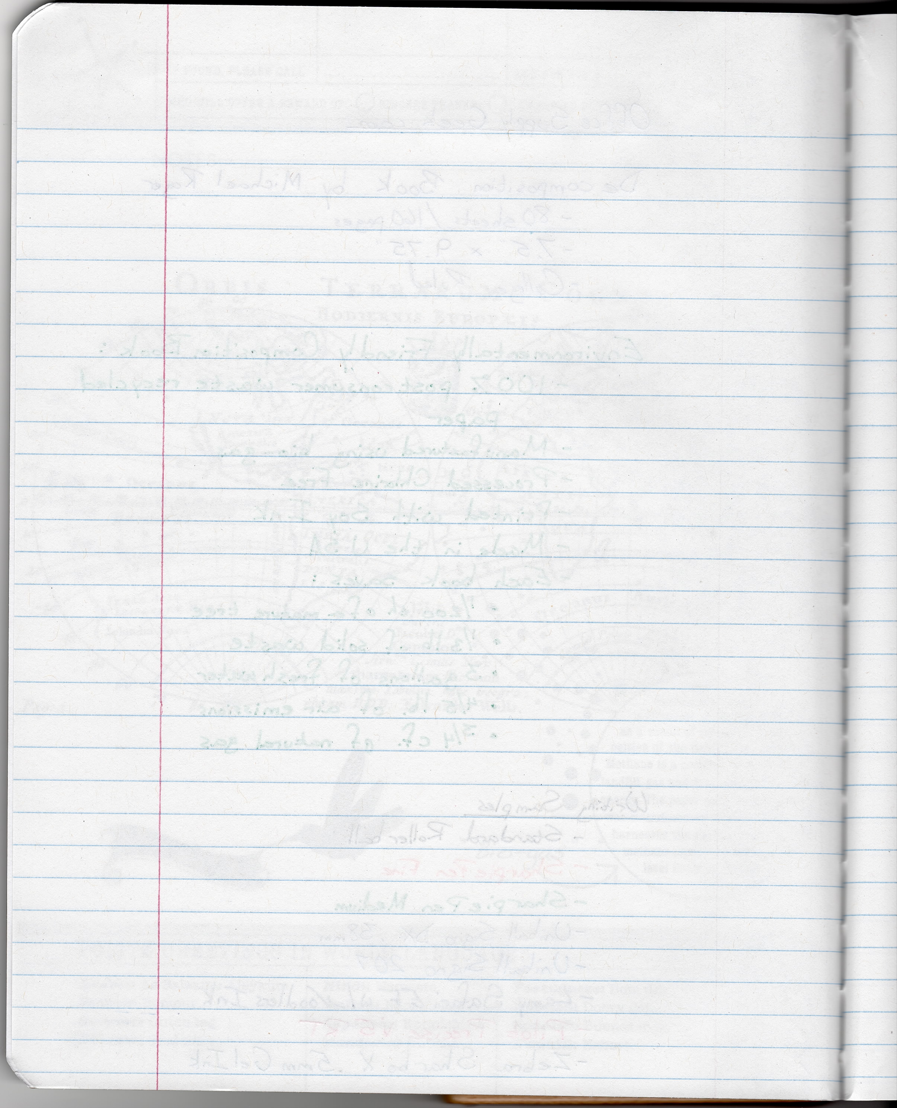
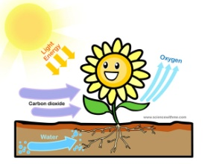
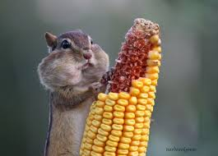
In Your Science Notebooks…
1. An organism is…
2. AN ORGANISM:
__________________
__________________
__________________
__________________
__________________
Any living being that carries its life out on its own.
Grows and Develops
Uses Energy (by photosynthesis or consumption)
Wastes
Reproduces
Responds to its environment

Slide 4
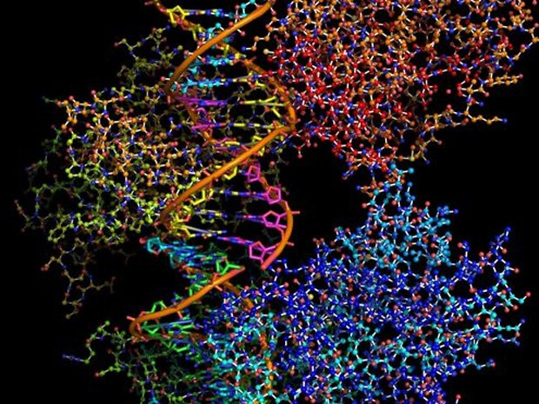
Needs of Organisms

Slide 5
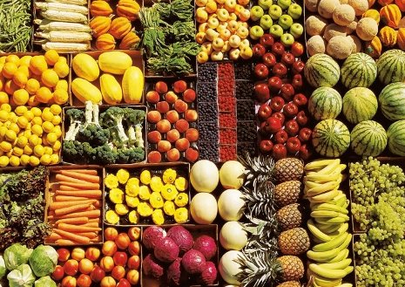
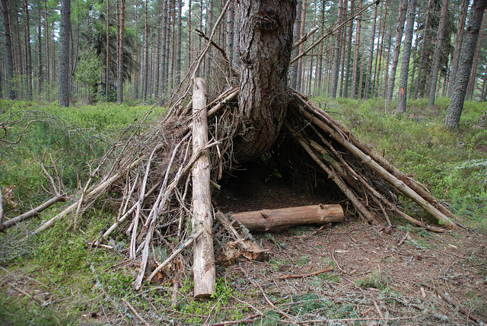
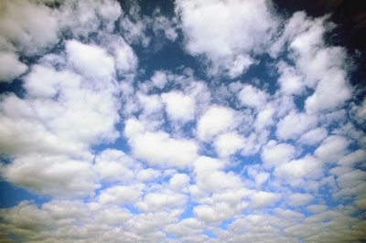
For animals to stay alive
They need four things, I would not lie
They need food so that they can grow
And they need water just like so
LIFE NEEDS, 1-2, A BREEZE, 3-4
They need shelter a place to live
And they need air, they breathe it in
LIFE NEEDS, 1-2, A BREEZE, 3-4

Slide 6
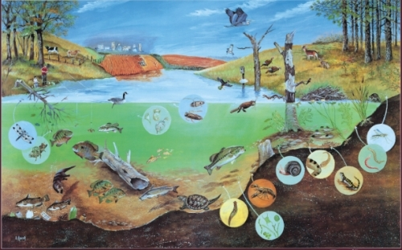
Ecosystem
All the living and nonliving things in an environment and their interactions with each other.

Slide 7
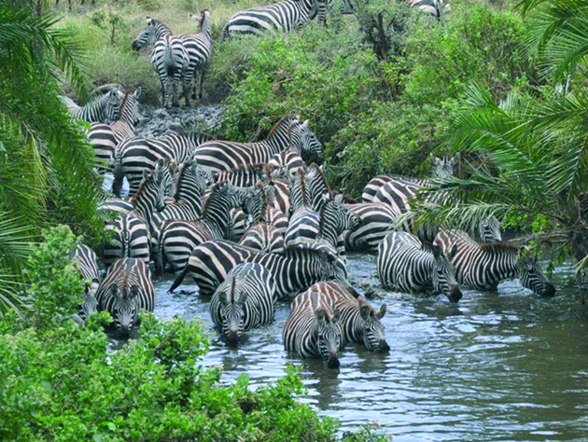
Population
All of the members of one species in an area

Slide 8
Community
All the living things in an ecosystem.

Slide 9
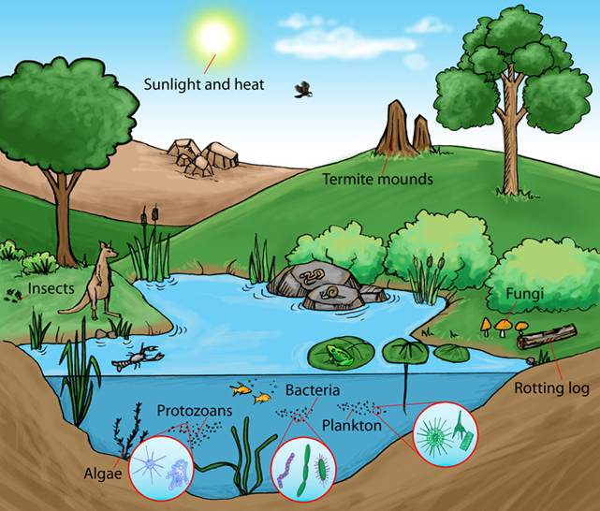

Slide 10
