Slide 1
5.E.1 Understand how a market economy impacts life in the United States. 5.E.2 Understand that personal choices result in benefits or consequences.
Economy

Slide 2
Show What You Know
Get into 4 teams.
Choose a scribe.
Jot down everything you know about budgeting and spending.

Slide 14
Reflection
What was Heather’s problem?
How did she earn the money she needed?
What else might Heather have done to earn the money she needed?

Slide 15
Economy
5.E.1 Understand how a market economy impacts life in the United States.
5.E.2 Understand that personal choices result in benefits or consequences.

Slide 16
Everything We Know about Budgeting and Spending:

Slide 17
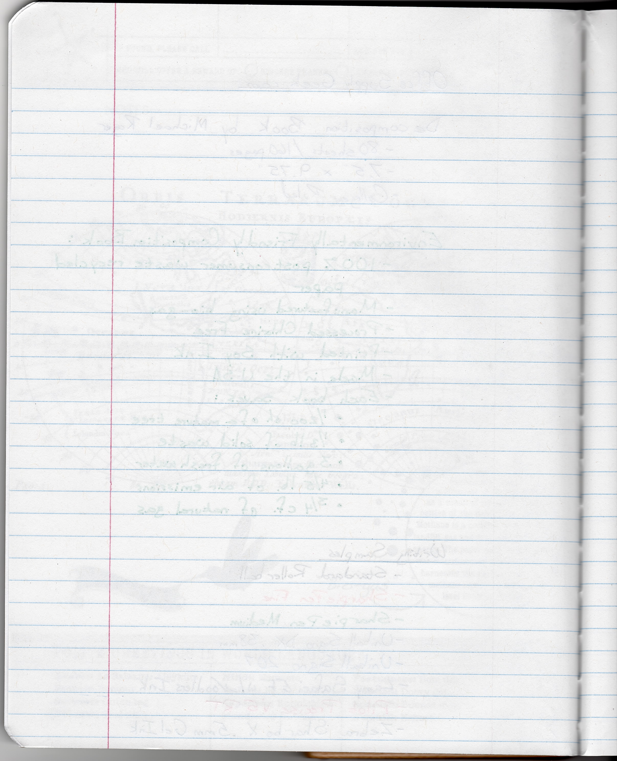
In Your Social Studies Notebook…
Explain how your knowledge of the terms budgeting and saving have changed.

Slide 18
Homework

Slide 19
Economy
5.E.1 Understand how a market economy impacts life in the United States.
5.E.2 Understand that personal choices result in benefits or consequences.

Slide 20
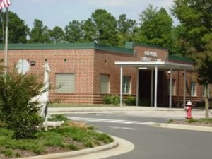
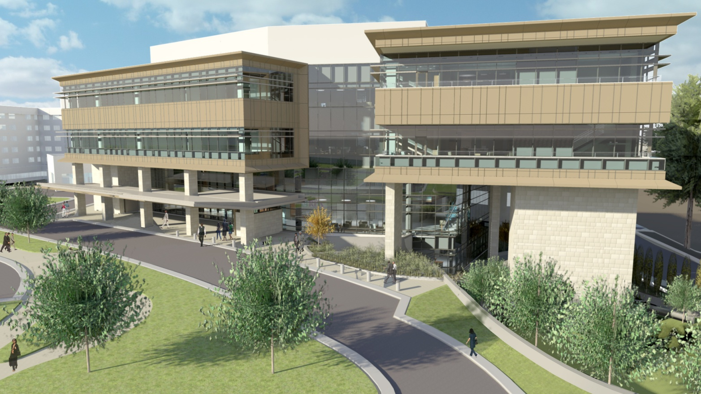
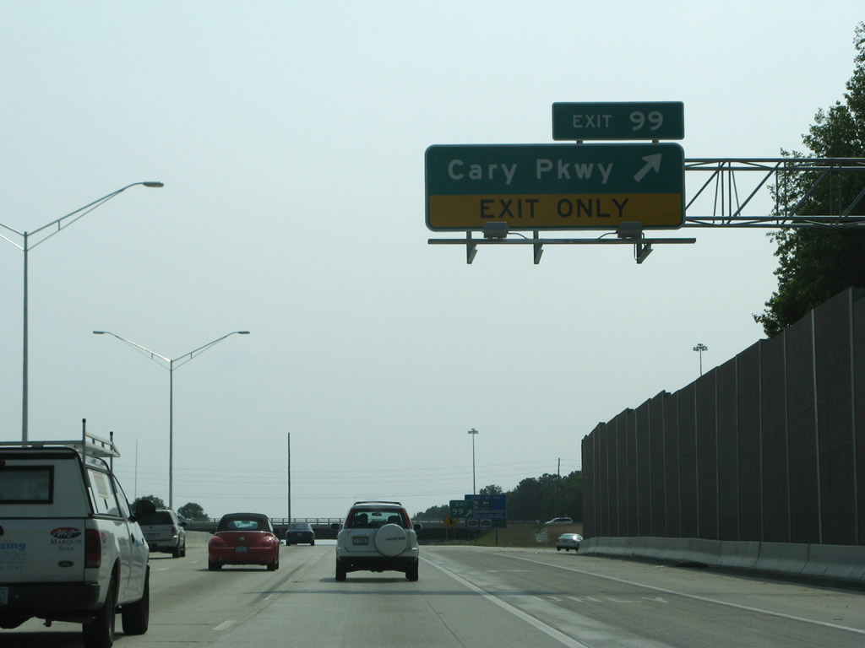

Slide 21
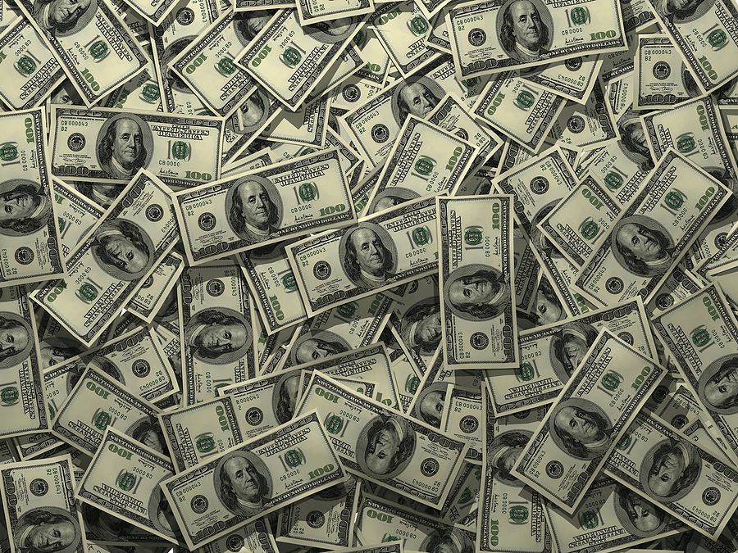
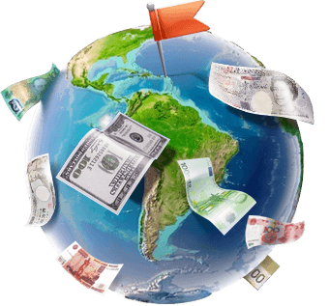
What is a tax?
Every person in the nation is responsible for paying taxes to keep public resources running. The money they pay is called a tax.

Slide 22
Budget
People in government decide how that money is spent. These decisions are written up in a plan that tells us how the tax payments, or REVENUE, will be spent.
This written plan is called a BUDGET.

